Slide 1



Car insurance Campaigns
View in Power BI
Last data refresh:
02/12/2020 17:34:45 UTC
Downloaded at:
20/05/2021 15:38:26 UTC

Slide 2
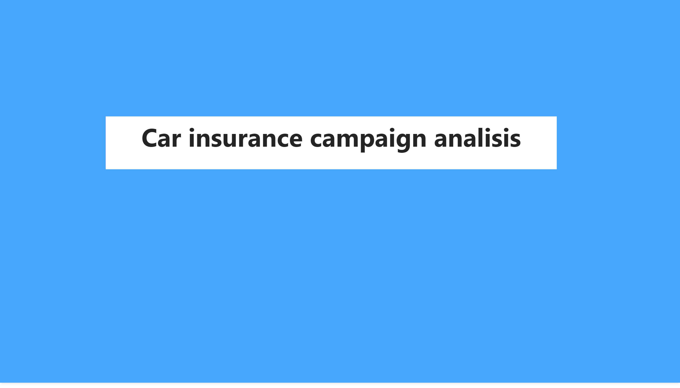
Portada
Notes:
textbox
No alt text provided.

Slide 3
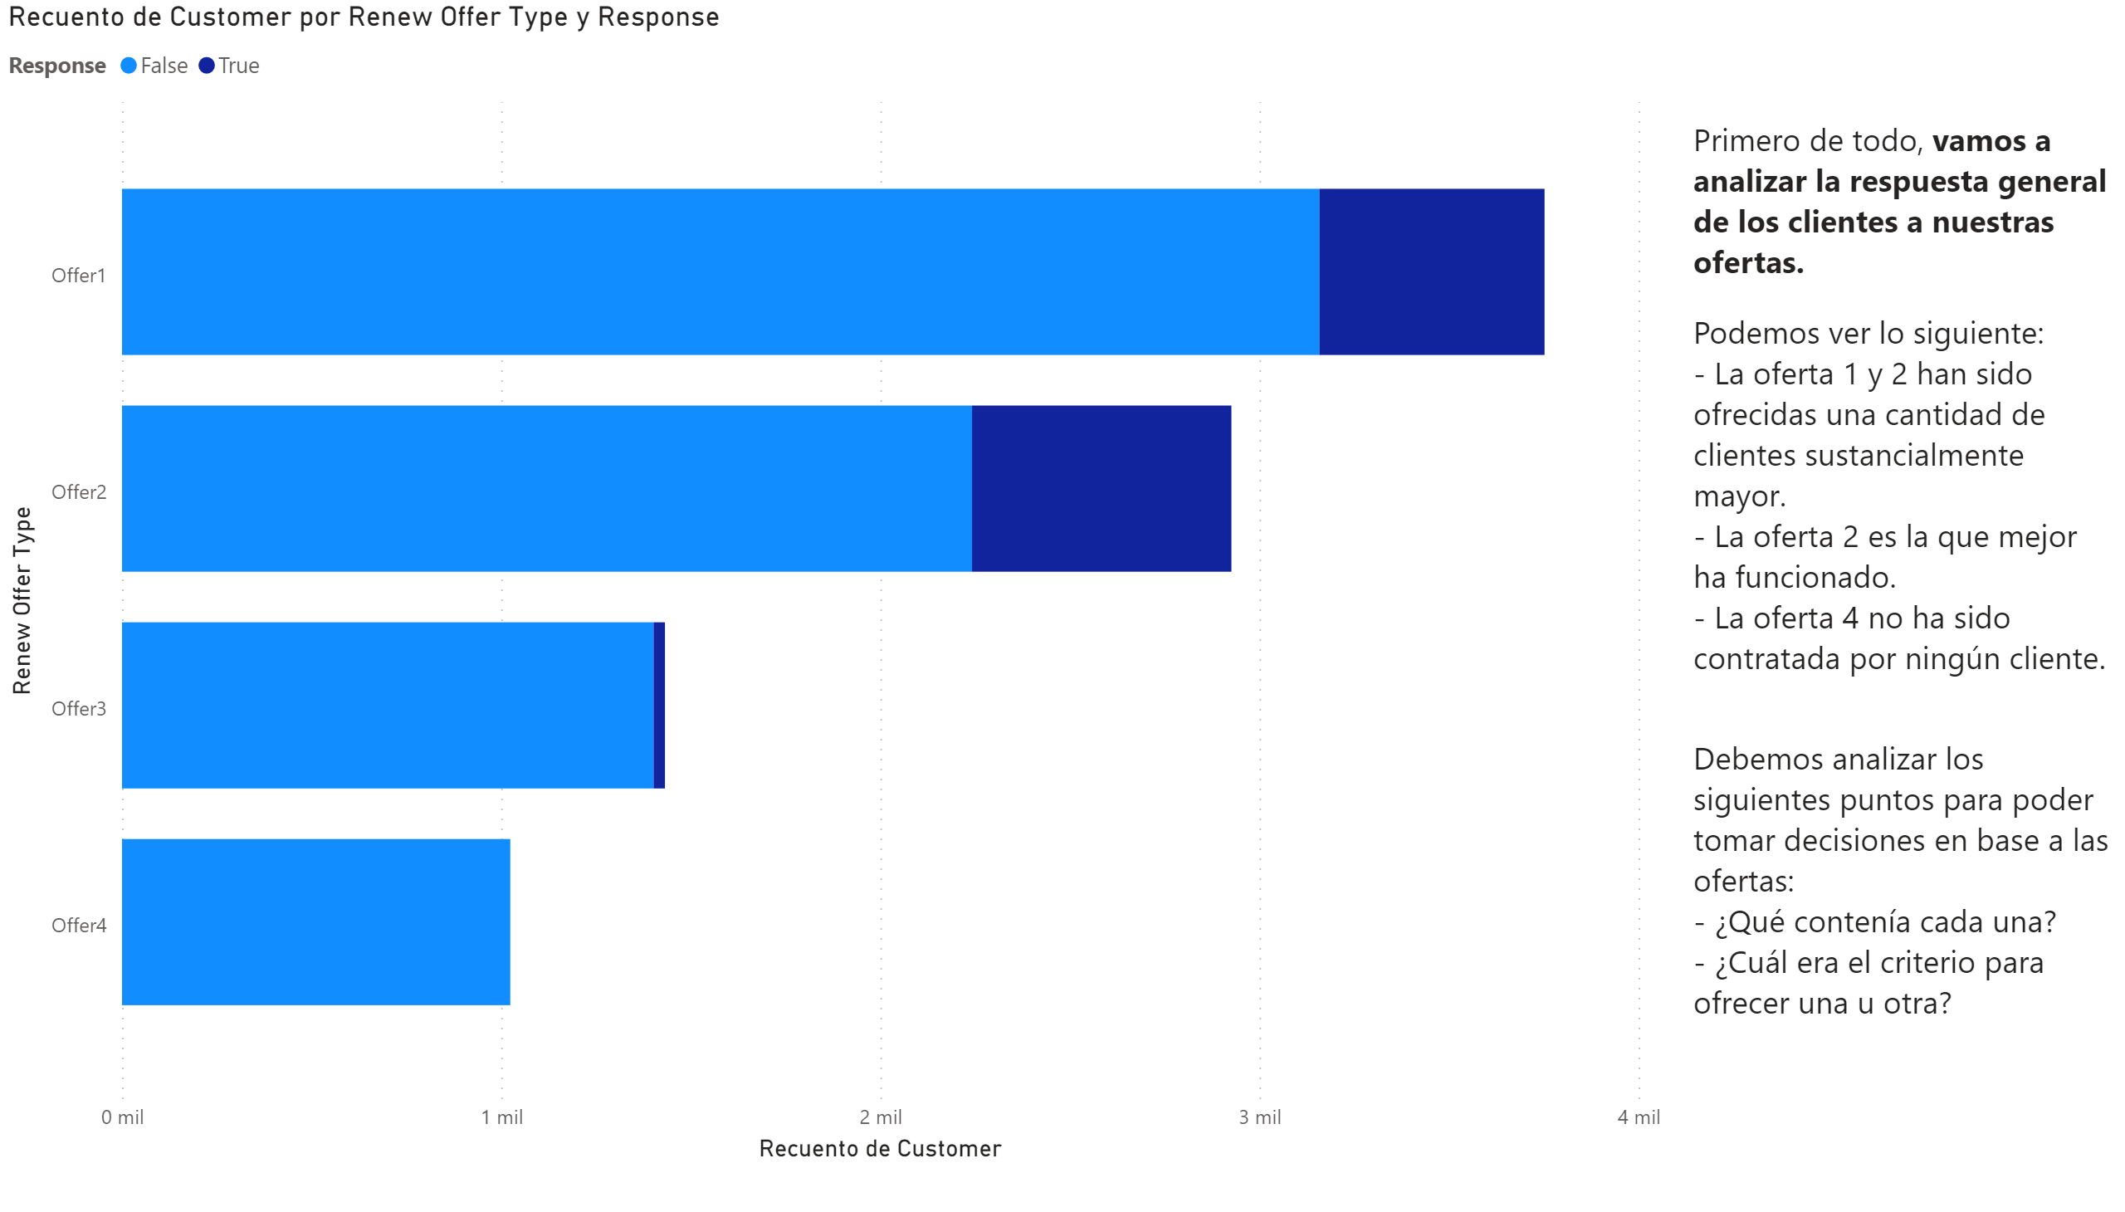
Offers
Notes:
barChart
No alt text provided.
textbox
No alt text provided.

Slide 4
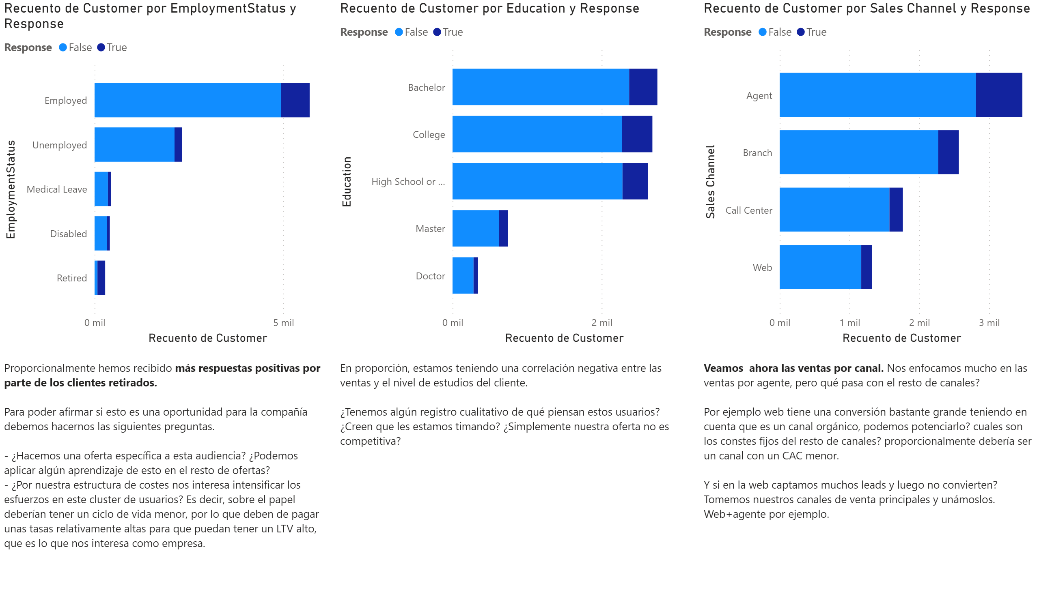
Insights
Notes:
barChart
No alt text provided.
barChart
No alt text provided.
barChart
No alt text provided.
textbox
No alt text provided.
textbox
No alt text provided.
textbox
No alt text provided.

Slide 5
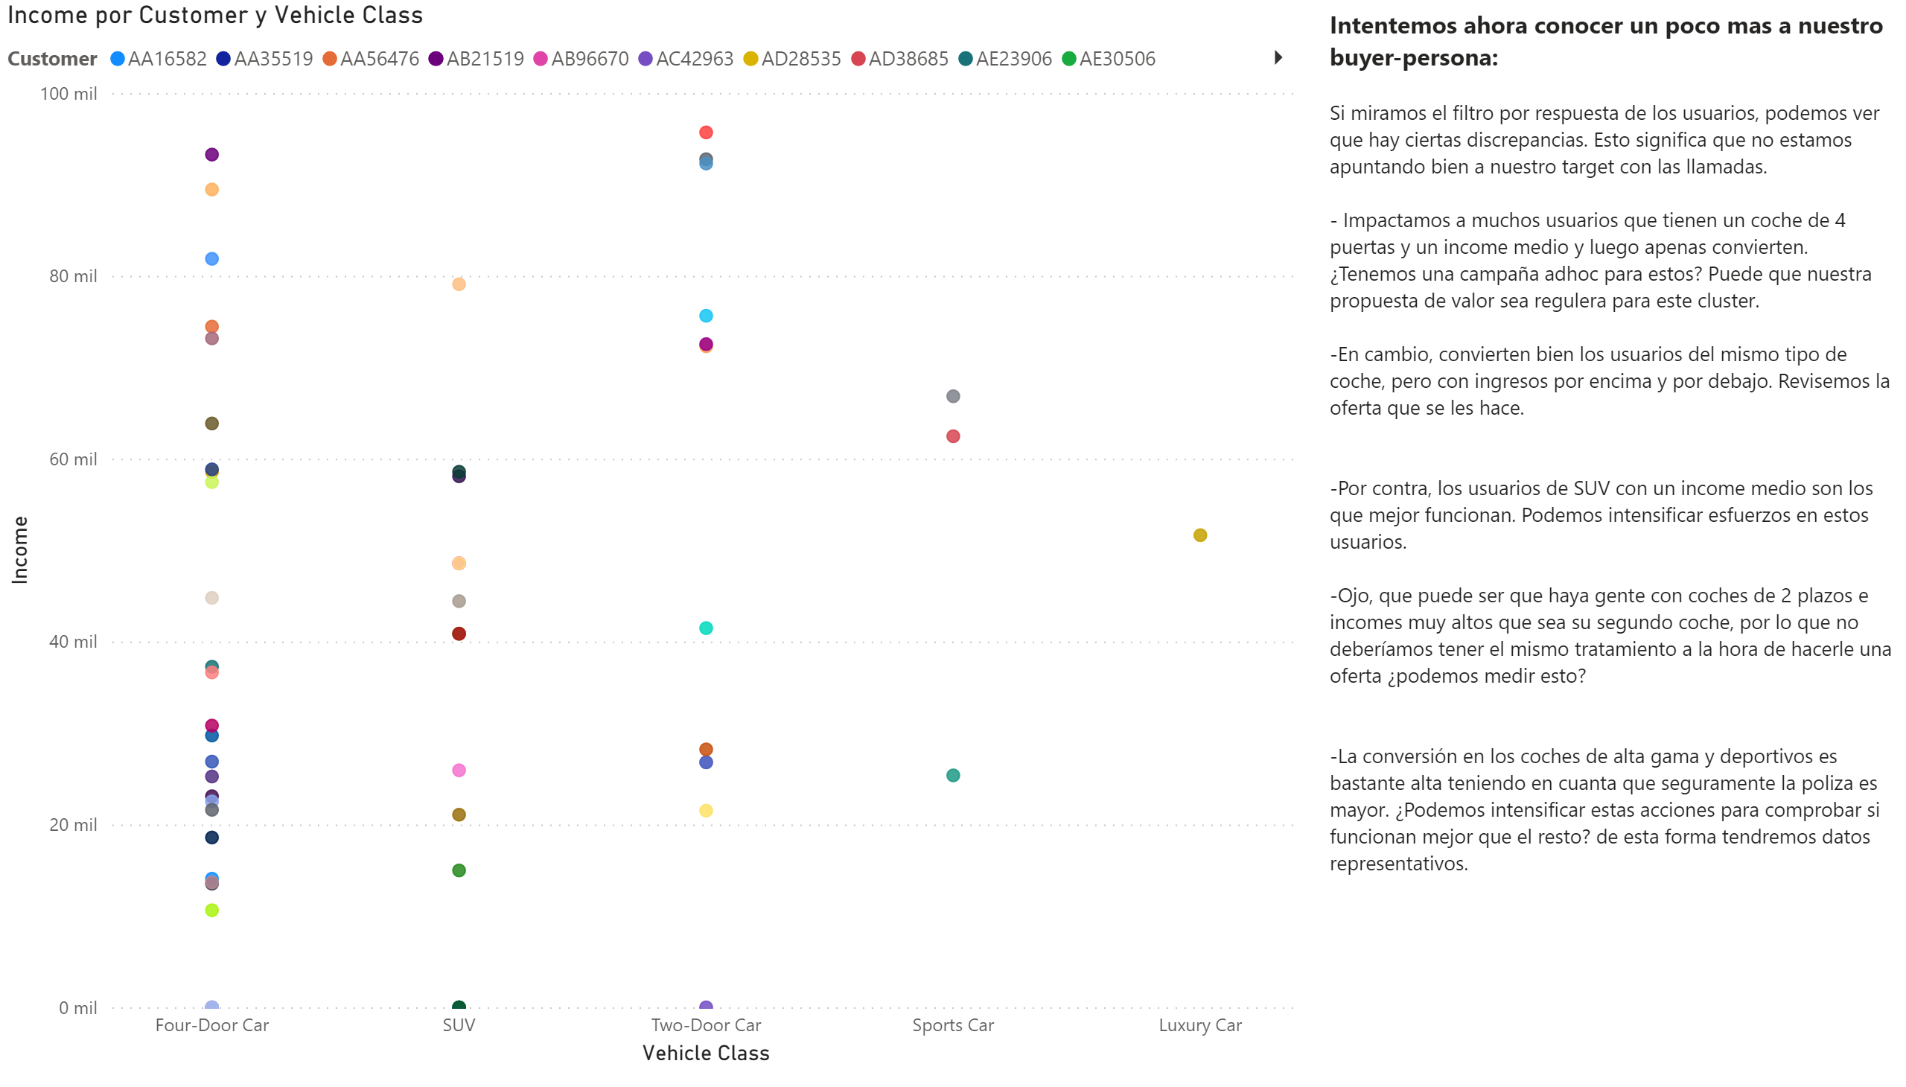
Buyer persona
Notes:
scatterChart
No alt text provided.
textbox
No alt text provided.

